Slide 1

Team Matplotlib dot pyplot
Team Members:
Lucas Munson
Katie Blood
Gloria Evans

Slide 2
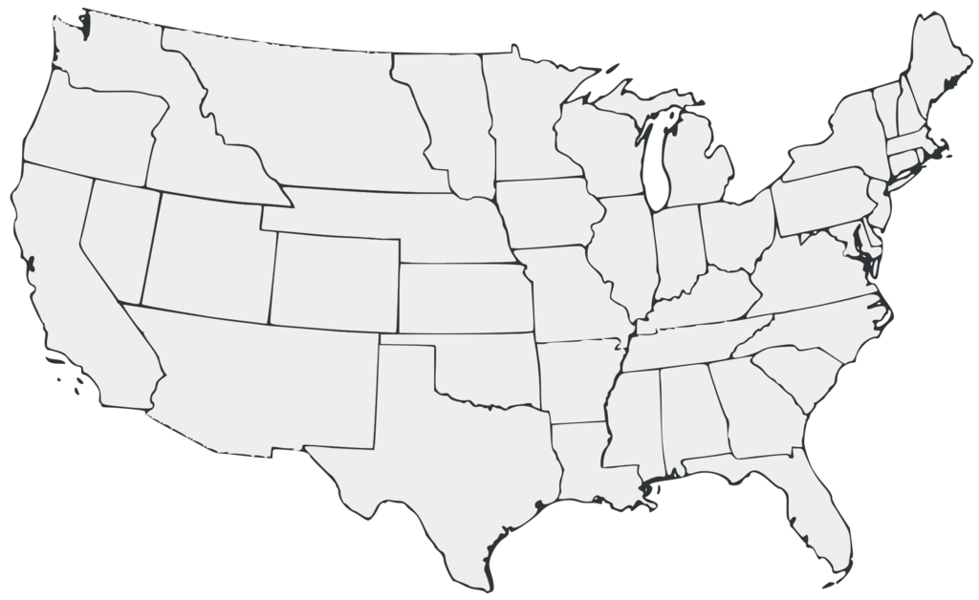
Mobility Changes in the U.S during the covid-19 Pandemic 2020-2021
Source: www.google.com/covid19/mobility/
This Photo by Unknown Author is licensed under CC BY-SA

Slide 3
Hypotheses:
An increase in Coronavirus cases will result in a decrease in the number of visitors at all locations and a decline in the usage of the transit system.
Grocery stores and pharmacies were still essential outings during the pandemic and therefore did not experience as great of a decrease in movement.
The more mobility people had in an area directly influenced the number of COVID-19 cases.

Slide 4
Limitations
The data used only goes back to the beginning of the pandemic, roughly February 2020.
The baseline used is five weeks from the beginning of the year 2020. There is no way to determine if the baseline is a representative week.
Parks also are a place that fluctuates based on the time of year. Visitation will be higher during the warmer months.
This dataset also includes weekends and holidays leading to some decreases in data

Slide 5
Methods
Merge – Combined years 2020 and 2021 data
Drop columns – Drop data not relevant to hypothesis
Datetime - To convert date column data into actual dates and to pull the days for the year over year comparison
Matplotlib.dates – To plot dates as x-axis tick marks
Plotly – To create the US state heatmap

Slide 6
ANOVA
With a p-value so small that it is not within the precision scope of a floating point number, we feel confident in rejecting the null hypothesis, and saying that the relationship between cases and people’s movement is statistically significant.
ANOVA Numbers: F- statistic: 462.39777712696065
P-Value: 0.0
statistic=462.39777712696065, pvalue=0.0)

Slide 7
A note from google www.google.com/covid19/mobility/
These Community Mobility Reports aim to provide insights into what has changed in response to policies aimed at combating COVID-19. The reports chart movement trends over time by geography, across different categories of places such as retail and recreation, groceries and pharmacies, parks, transit stations, workplaces, and residential.
The Community Mobility Reports were developed to be helpful while adhering to our stringent privacy protocols and protecting people’s privacy. No personally identifiable information, such as an individual’s location, contacts or movement, will be made available at any point.
Insights in these reports are created with aggregated, anonymized sets of data from users who have turned on the Location History setting, which is off by default. People who have Location History turned on can choose to turn it off at any time from their Google Account and can always delete Location History data directly from their Timeline.

Slide 8
Data considerations
The baseline is an aggregate of five weeks of data from January to February 2020
All other data is the percent change from this baseline number
Factors that influence spikes in the data include: Weekends, and holidays.
Park data is influenced by seasonality and weather

Slide 9
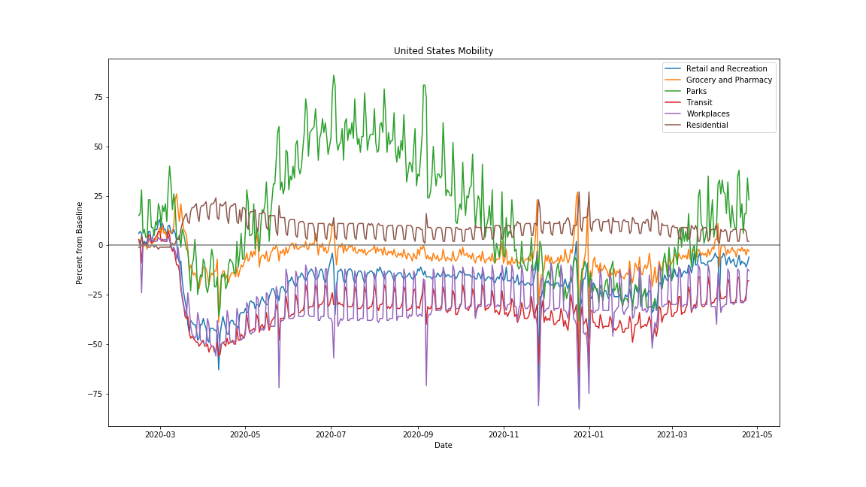
National mobility during covid-19

Slide 10
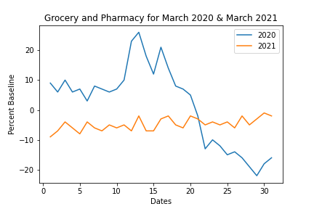
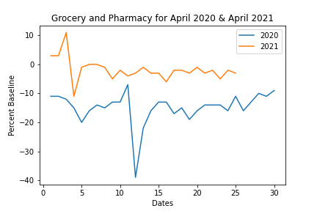
Grocery and pharmacy comparison

Slide 11
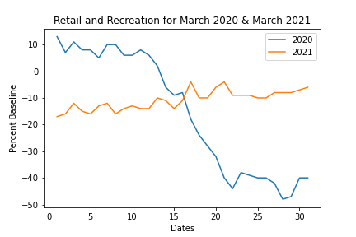
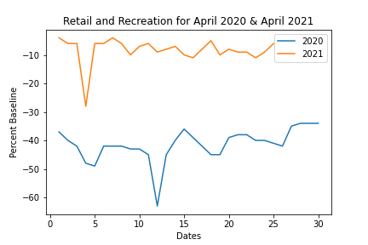
Retail and recreation comparison

Slide 12
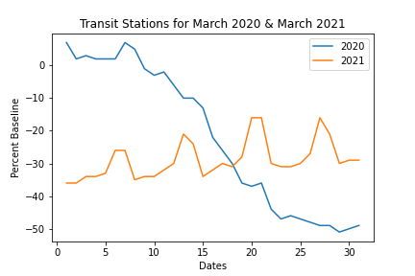
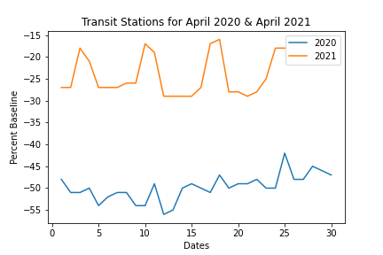
Transit station comparison

Slide 13
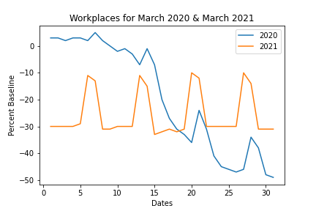
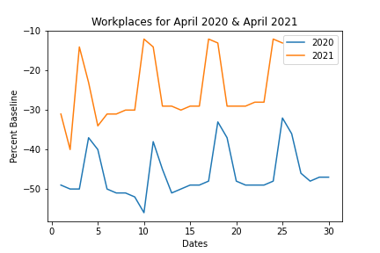
Workplace comparison

Slide 14
State breakouts
California
Shutdown: March 19 2020
Total Cases as of 5 May 2021: 3.3 Million
Wyoming
Shutdown: State of Emergency declared but no Stay-at-Home ordered
Total Cases as of 5 May 2021: 50 Thousand
Last state to report a COVID related death
Hawaii
Shutdown: March 25th 2020
Total Cases as of 5 May 2021: 31 Thousand
Florida
Shutdown: April 3rd 2020
Total Cases as of 5 May 2021: 2.2 Million
First state to completely reopen
Experienced a “mini-surge” mid-April 2021
North Dakota
Shutdown: State of Emergency declared March 13th but no Stay-at-Home ordered
Total Cases as of 11 March 2021: 101 Thousand

Slide 15
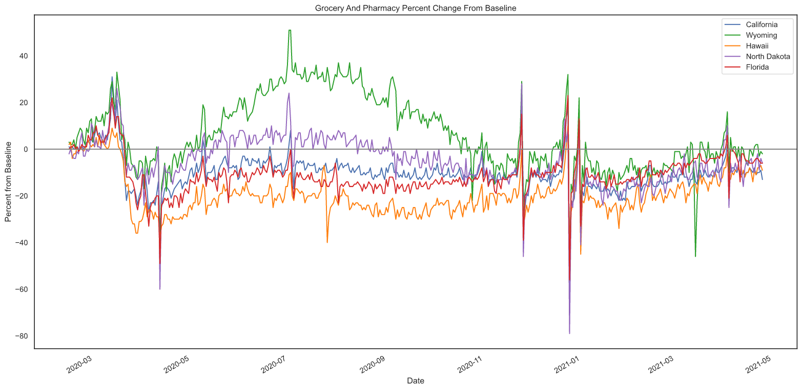
State Grocery and pharmacy mobility

Slide 16
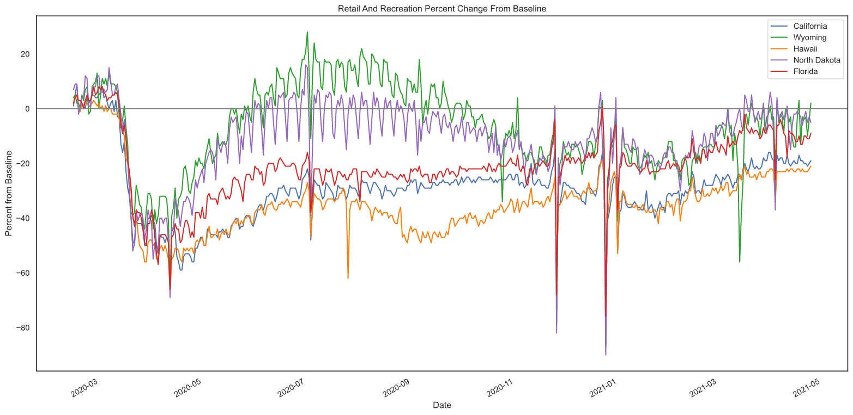
State Retail and recreation mobility

Slide 17
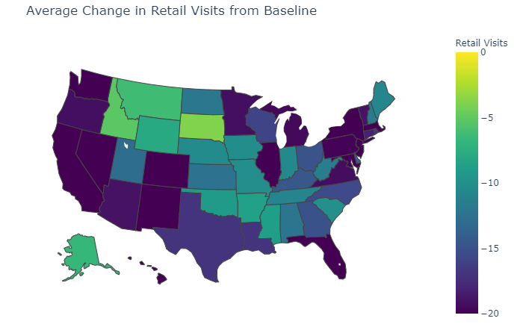
Heatmap of retail visits
ANOVA:
We chose a p-value of 0.05 for this particular test, and predictably our p-value was far below this threshold at
p-value=6.332117146935177e-214

Slide 18
summary
We found that there is a statistically significant relationship between states and movement data.
We did find that grocery stores and pharmacies showed a smaller retraction in number of visitors during the pandemic.
We also found that the pandemic had a significant effect on all types of movement data except parks, which saw a large upswing. This upswing can be explained by a seasonal swing, and by people’s willingness to engage in outdoor activities compared to indoor activities during the pandemic.

Slide 19
Further research and team thoughts
Adding a multi-variable linear regression using case data would be interesting. That way we could make a predictive model that would project future cases based on movement data.
Finding additional data sources to provide 2019 data for a more realistic baseline and further year comparisons.
Drilling down into county-level data for a more complete look at the rural/urban divide that exists during the pandemic.

Slide 20
Any Questions?

